Slide 1
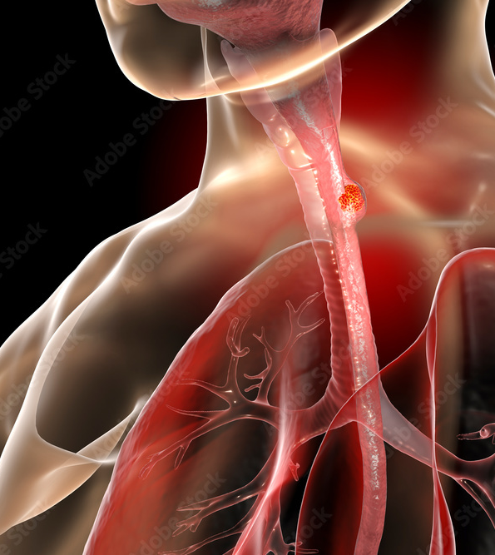
Design and Implementation of an Advanced Healthcare Database System: Optimizing Data Storage, Management, and Analytical Insights for Esophageal Cancer Treatment Outcomes
Sameer mohammad

Slide 2

INTRODUCTION
Esophageal cancer is a leading cause of cancer-related deaths, often diagnosed late in its progression.
The complexity of managing patient records, tumor progression, and treatment outcomes creates challenges in delivering efficient, data-driven care.
Healthcare systems often struggle to organize and analyze this data in a structured way. A well-designed database system is crucial to managing esophageal cancer data, ensuring that clinical records are stored efficiently and are accessible for analysis, and enabling healthcare providers to make informed decisions that improve patient outcomes.
By integrating visualizations and geographical mapping, the system will help clinicians analyze patient data for improved treatment outcomes.

Slide 3

DATASET
Dataset: https://www.kaggle.com/datasets/abhinaba1biswas/esophageal-cancer-dataset/data
The dataset contains detailed information on esophageal cancer patients, covering demographic, clinical, and treatment-specific data points.
Key fields include:
Patient Demographics: patient_id, gender, country_of_birth, country_of_procurement, race_list.
Tumor Data: icd_o_3_site, icd_o_3_histology, icd_10, primary_pathology_tumor_tissue_site, primary_pathology_histological_type.
Treatment Data: person_neoplasm_cancer_status, vital_status, days_to_last_followup, days_to_death, treatment_prior_to_surgery, radiation_therapy, postoperative_rx_tx.
Outcome Data: karnofsky_performance_score, primary_pathology_residual_tumor, primary_pathology_lymph_node_examined_count, number_of_lymphnodes_positive_by_he.

Slide 4

OBJECTIVE
This project focuses on designing and implementing a relational database for esophageal cancer data, aiming to enable healthcare providers and researchers to analyze patient demographics, treatment effectiveness, and clinical outcomes.
The database incorporates advanced features, including data visualization and geographical mapping, highlighting trends and disparities across different regions. These capabilities will provide valuable insights into clinical data, facilitating better understanding and decision-making in cancer treatment and research.
Additionally, the database is structured for seamless integration with machine learning models to support predictive analytics in the future.
This design ensures scalability and adaptability, enabling the inclusion of additional datasets and features such as clinical decision support systems (CDSS).
By prioritizing efficient data storage, retrieval, and advanced analytics, the project establishes a strong foundation for data-driven healthcare improvements and enhanced patient care outcomes.
This Photo by Unknown Author is licensed under CC BY-SA-NC

Slide 5
Roles and responsibilities
NAMES | Role | Responsibilities
SAMEER | Database Architect | Created the database design and optimized its structure to ensure efficient data storage and retrieval. Applied normalization techniques and indexing strategies to improve query performance. Refined the Entity-Relationship (ER) diagram to ensure it aligned with project requirements.
BHARGAV | Data Analyst | Preprocessed the dataset using Python to clean and standardize the data for analysis and machine learning modeling. Developed interactive visualizations using Plotly and Matplotlib to showcase trends in patient data, treatment effectiveness, and demographics. Implemented visualizations and geographical mapping to visualize regional trends in esophageal cancer prevalence and treatment outcomes.
VERONICA | Visualization and User Experience Designer | Prepared comprehensive documentation detailing the system’s use, database schema, ER diagram, and machine learning models Worked on preparing the user interface for the database and improving the overall user experience. Enhanced the visualization components, focusing on making the data accessible and actionable through interactive interfaces and graphical representations.

Slide 6

methodology

Slide 7

Database Design Overview
The relational database is designed using MySQL, structured to store and analyze esophageal cancer data efficiently. It organizes information into core entities such as patients, diagnoses, treatments, visits, outcomes, and country details, ensuring optimized data retrieval and maintaining data integrity..
ER Diagram Details The database comprises the following entities and attributes:
Patient Table: Includes unique patient identifiers (patient_id), demographic details (e.g., country_of_birth), and tissue-related information.
Country Table: Normalizes geographical data with attributes like country_of_birth, country_of_procurement, and city/state details.
Visit Table: This table tracks patient visits with visit dates and visit-related IDs, linking patients to their clinical timelines.
Diagnosis Table: Records initial diagnoses, cancer status, tumor characteristics, and pathology results.
Treatment Table: Captures details of treatments provided, such as types of therapies and residual tumor statuses.
Outcome Table: Documents patient outcomes, including performance scores (e.g., Karnofsky score), ECOG status, and vital status.
Schema Design Each table is defined with a primary key (e.g., patient_id, diagnosis_id) and linked via foreign keys to ensure referential integrity. The design supports normalization (3NF), reducing redundancy and optimizing esophageal cancer data analysis storage and querying. This structure facilitates efficient data visualization, geographical trend mapping, and predictive analytics integration..

Slide 8
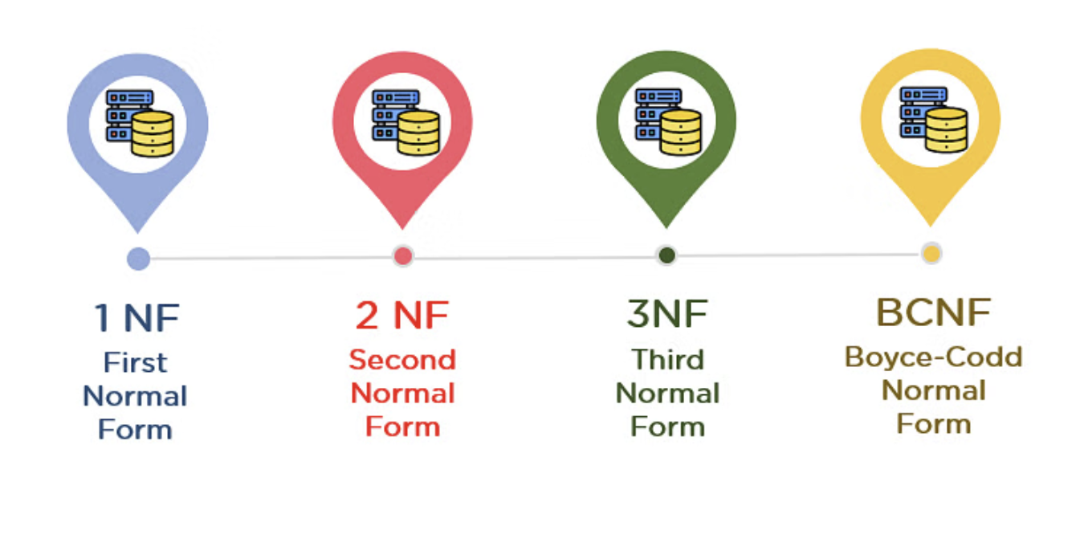
Normalization
1NF
All tables (patient_table, visit_table, treatment_table, diagnosis_table, country_table, outcome_table) meet 1NF criteria as they have atomic columns and no repeating groups.
2NF
All tables meet 2NF Criteria :patient_table: No partial dependencies, as all attributes depend on patient_id. visit_table: All attributes depend on visit_id.treatment_table, diagnosis_table, country_table, outcome_table: All attributes depend on their respective primary keys.
3NF
All tables meet 3NF Criteria: No transitive dependencies exist. Attributes in each table are entirely functionally dependent on their respective primary keys.
BCNF
The schema adheres to BCNF as all functional dependencies are resolved, and there are no violations.

Slide 9
RELATIONSHIPS
One-to-Many Relationships:
Patient Table to Visit Table One patient can have multiple visits, but each visit is associated with only one patient.
Visit Table to Diagnosis Table One visit can have multiple diagnoses, but each diagnosis is linked to only one visit.
Visit Table to Outcome Table One visit can result in multiple outcomes, but each outcome is associated with only one visit.
Visit Table to Treatment Table One visit can be associated with multiple treatments, but each treatment is linked to only one visit.
Many-to-One Relationships:
Patient Table to Country Table Each patient is associated with only one country (for birth and procurement), but a country can have many patients.
Visit Table to Country Table Each visit is associated with only one country (through the country of procurement), but a country can have multiple visits

Slide 10
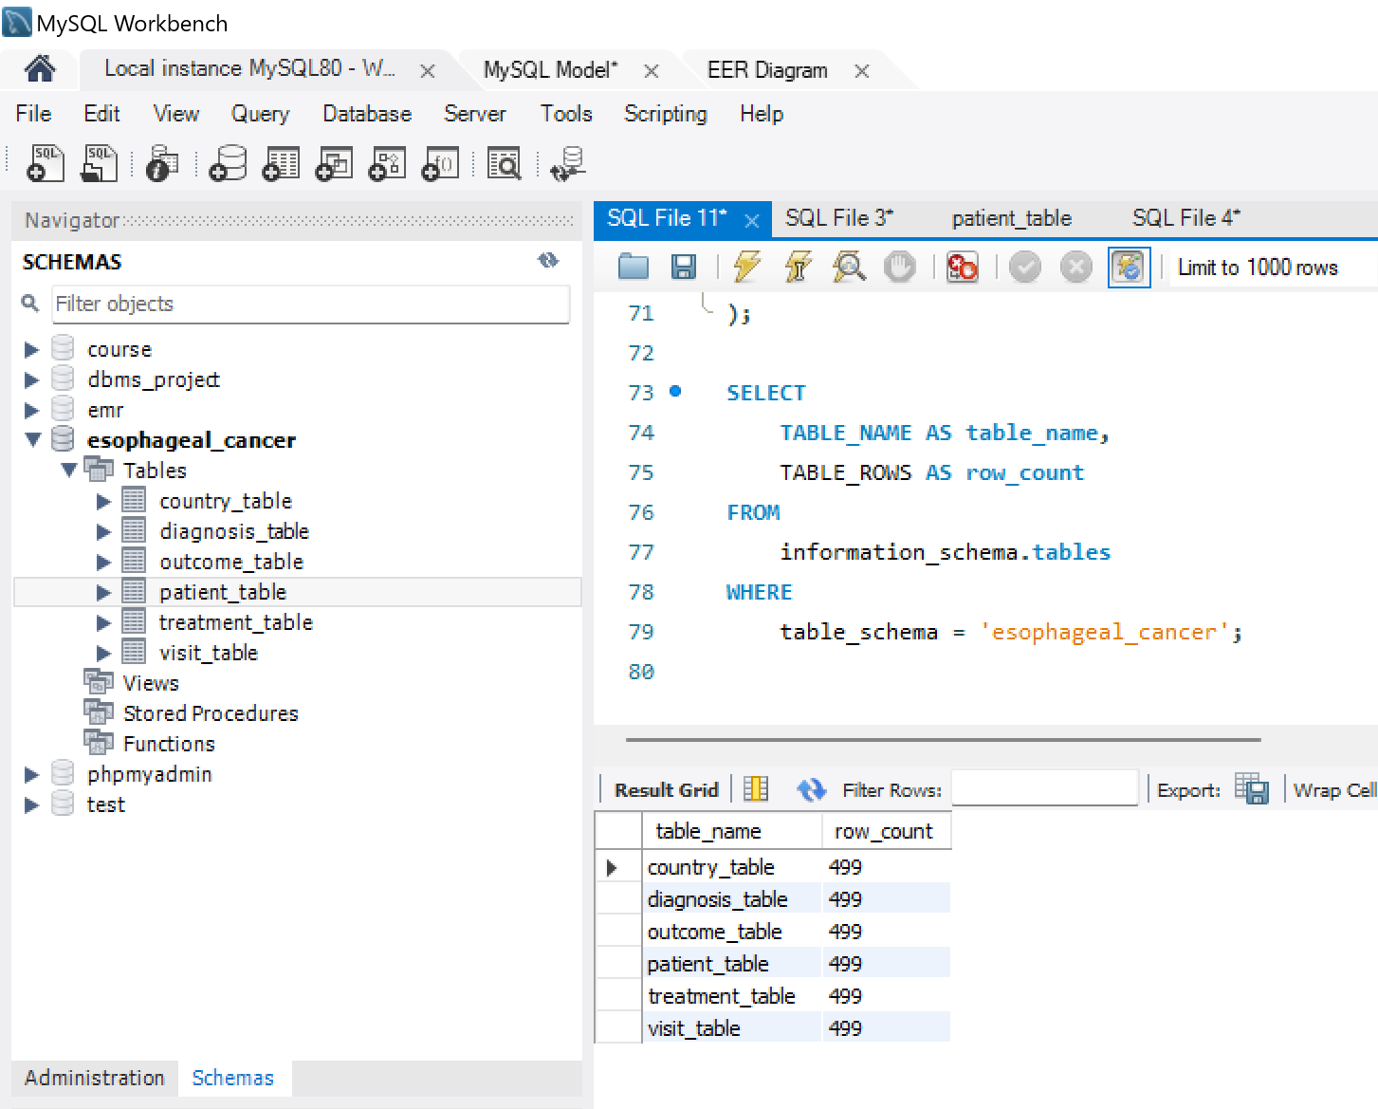
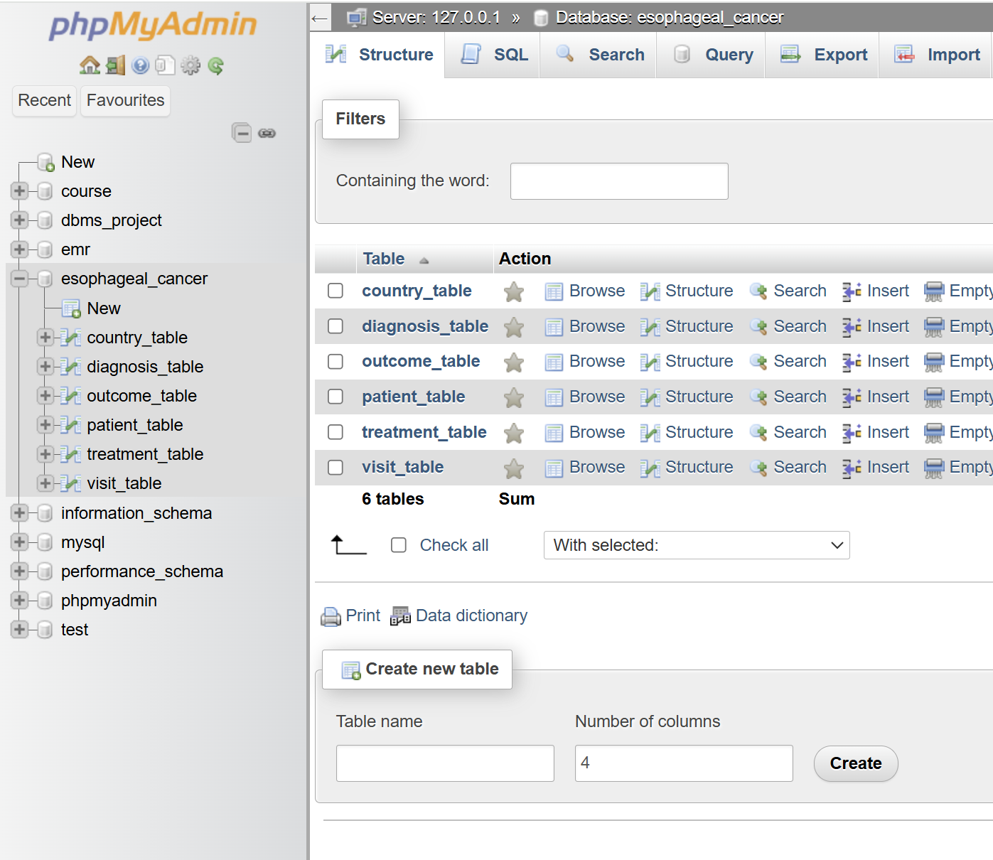
MY SQL WORKBENCH and php my admin

Slide 11

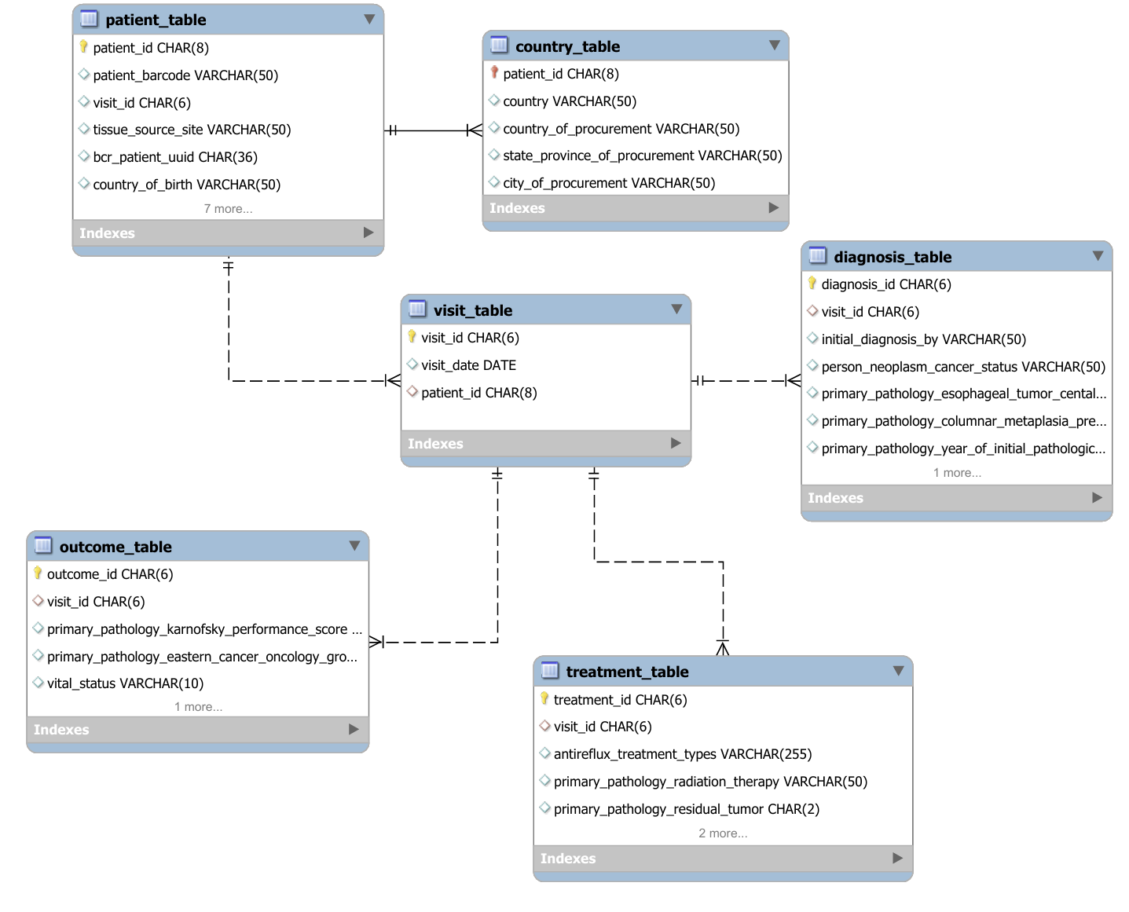
Entity Relationship Diagram for Esophageal Cancer Database - SQL Schema

Slide 12
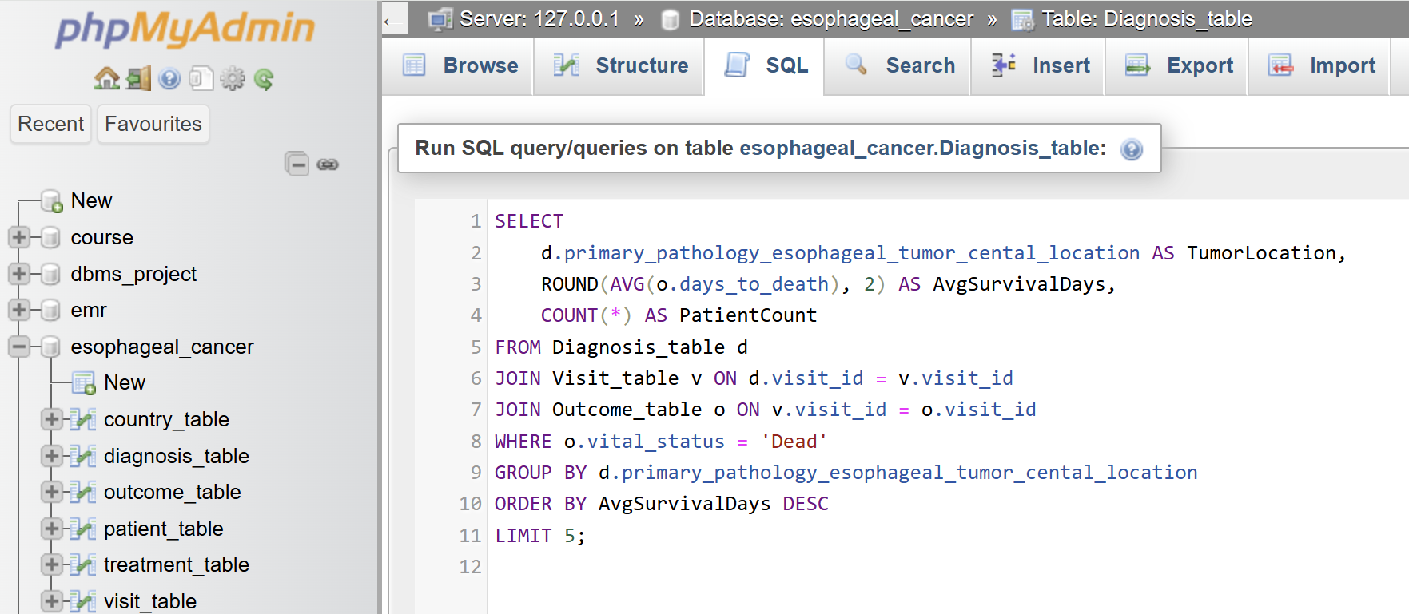
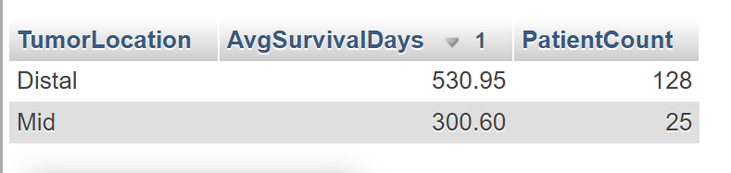
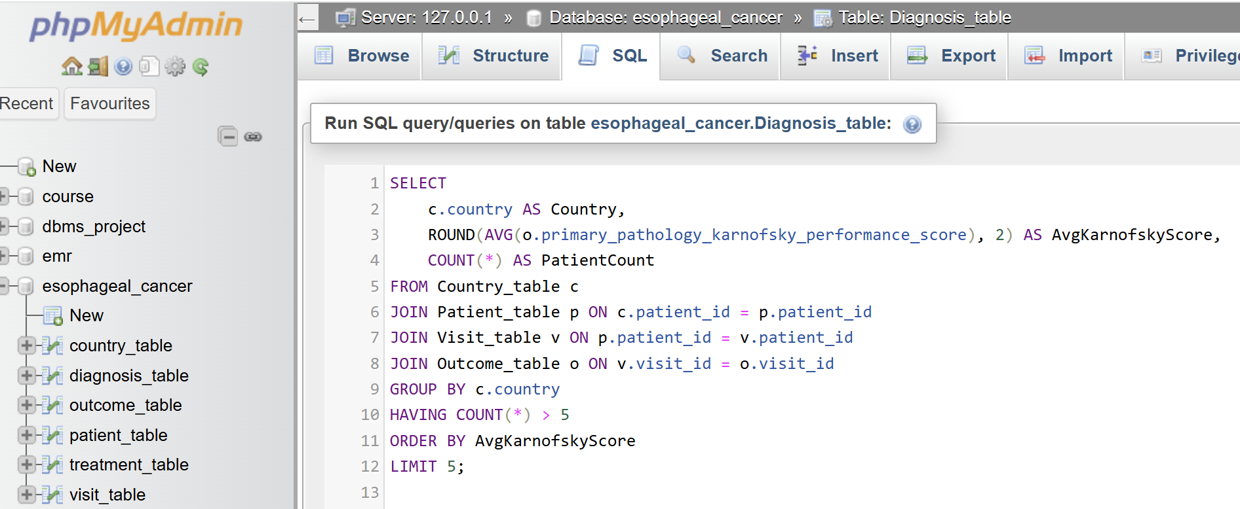
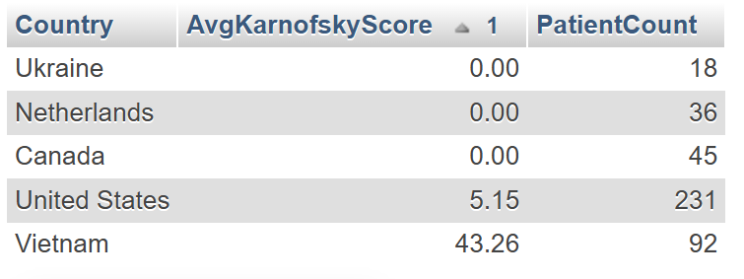
1. Patients with the Longest Survival Times by Tumor Location Identifies the tumor locations with the longest average survival times and lists the top 5 locations.
2. HIGH-RISK COUNTRIES BASED ON KARNOFSKY PERFORMANCE SCORES IDENTIFIES THE COUNTRIES WITH THE LOWEST AVERAGE KARNOFSKY PERFORMANCE SCORES, INDICATING POOR PATIENT CONDITIONS.

Slide 13
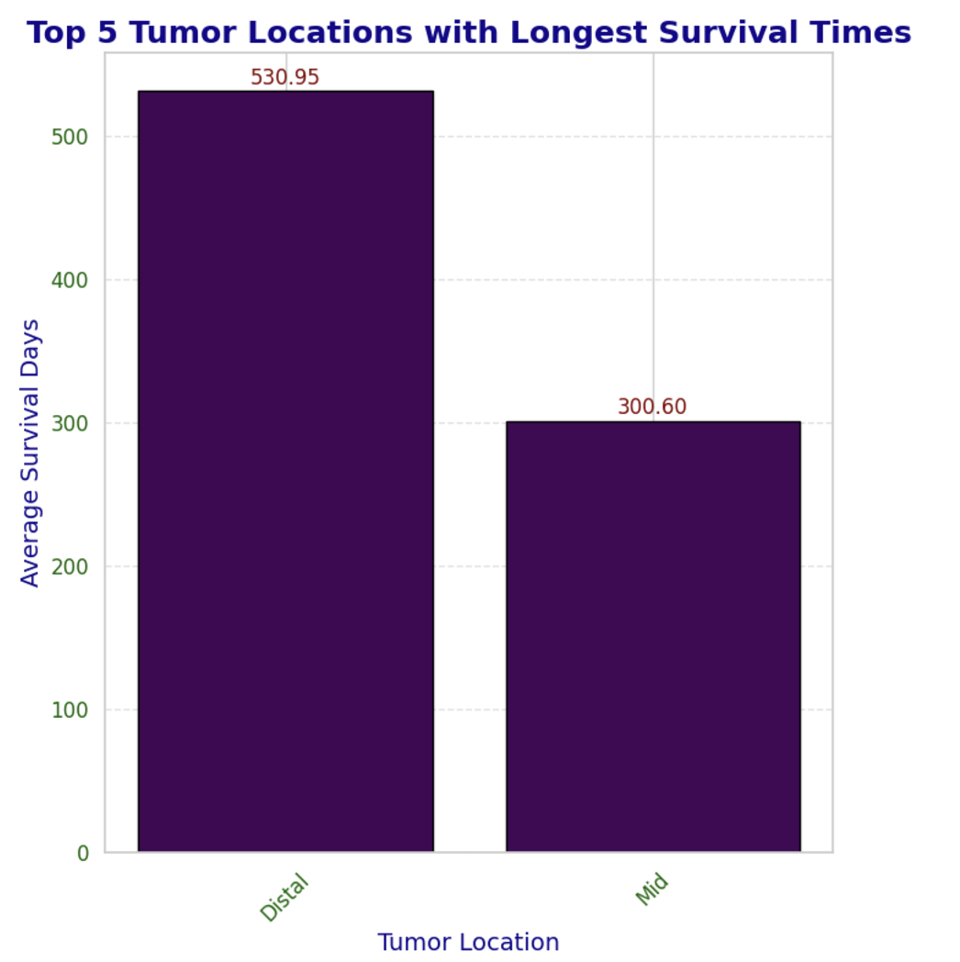
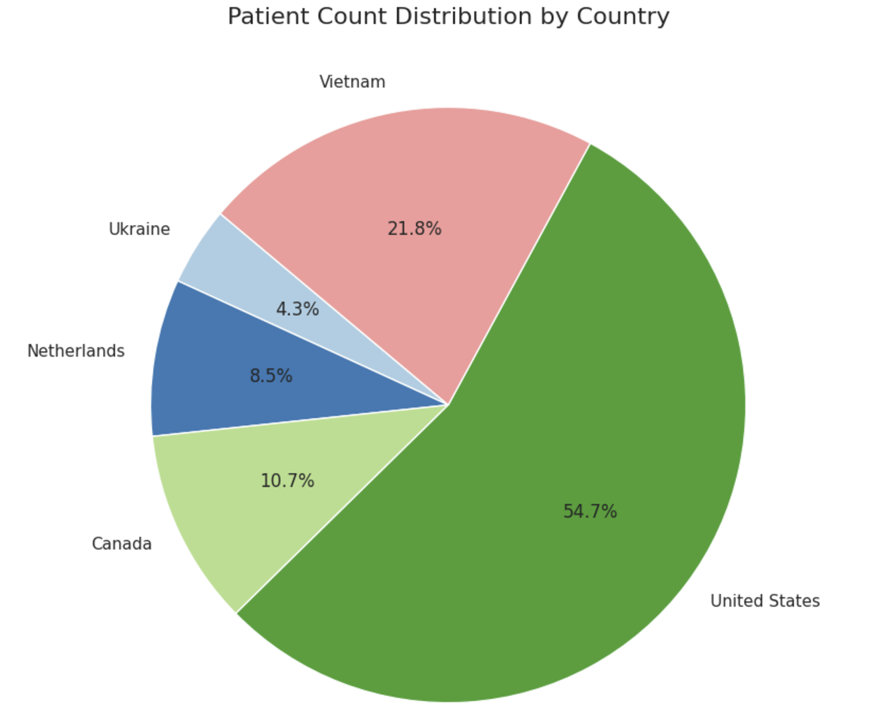
Tumors in the "Distal" location have the highest survival time (530.95 days), followed by "Mid" tumors (300.60 days).
Distribution of patients by country with the United States contributing the largest share (54.7%) and Vietnam (21.8%) and Canada (10.7%) show smaller proportions.

Slide 14
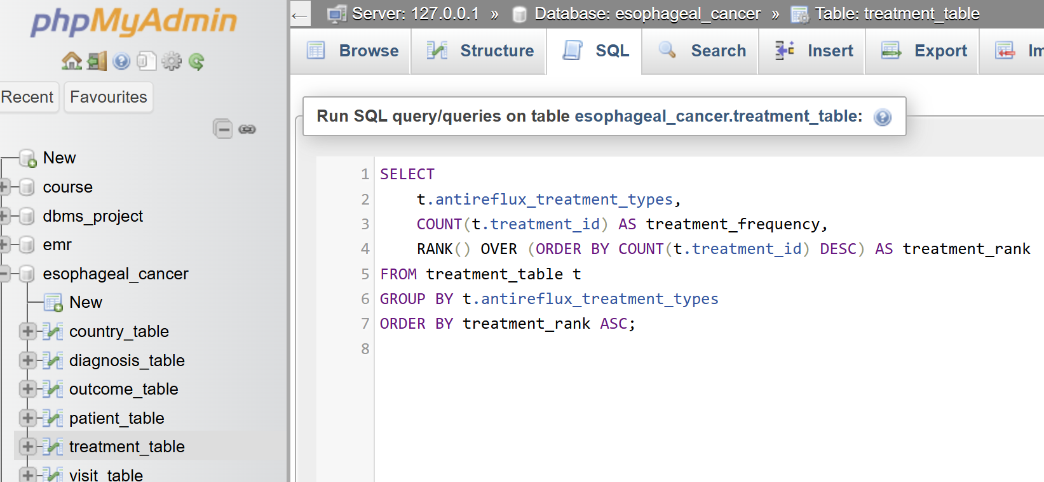
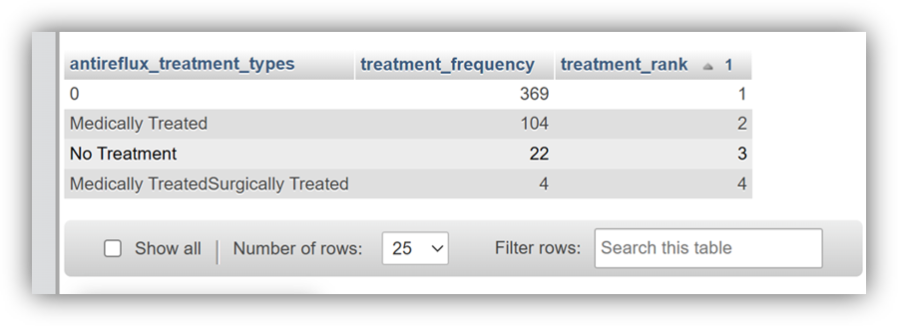
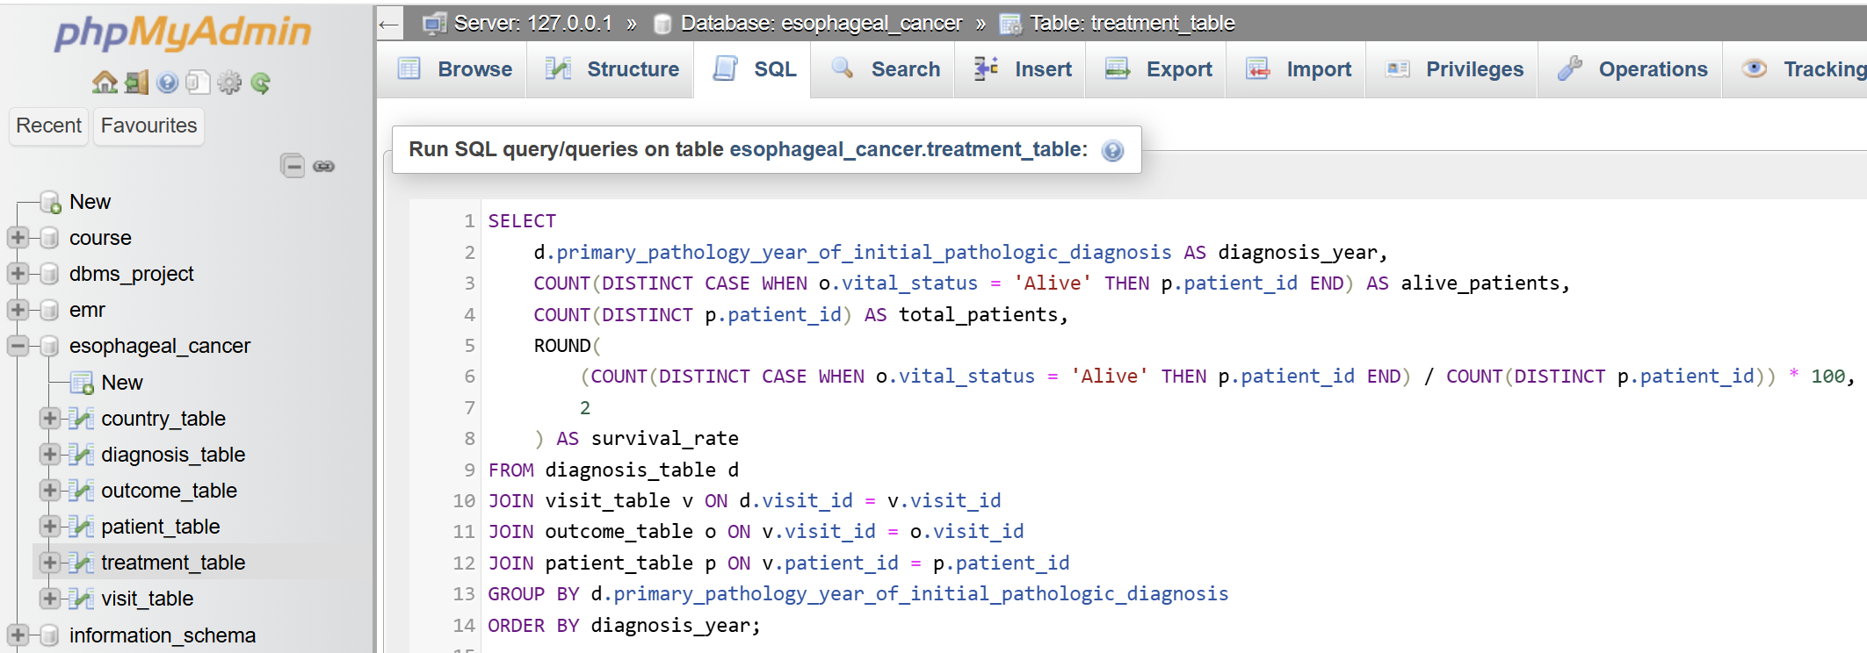
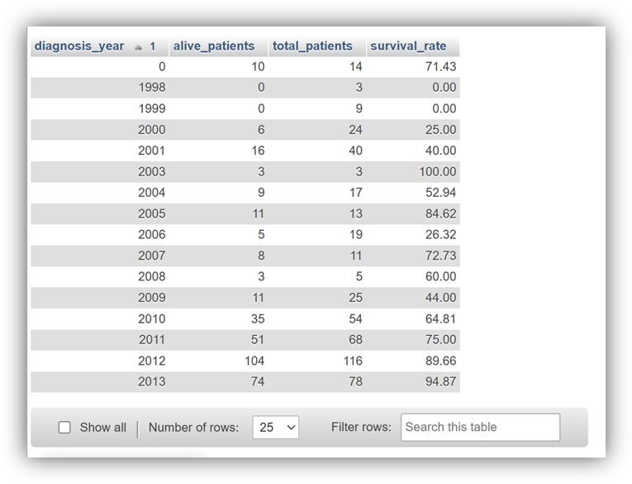
SQL QUERY
3. Analyzing Treatment Frequency and Ranking by Antireflux Treatment Types
Identify and ranking antireflux treatment types by their frequency in the treatment_table, sorted by rank in ascending order.
4. Calculating Patient Survival Rates by Primary Pathology Diagnosis Year
Write an SQL query to calculate the survival rate of patients based on their primary pathology diagnosis year, including the total number of patients, the number of alive patients, and the survival rate percentage, grouped by diagnosis year and sorted in ascending order.

Slide 15
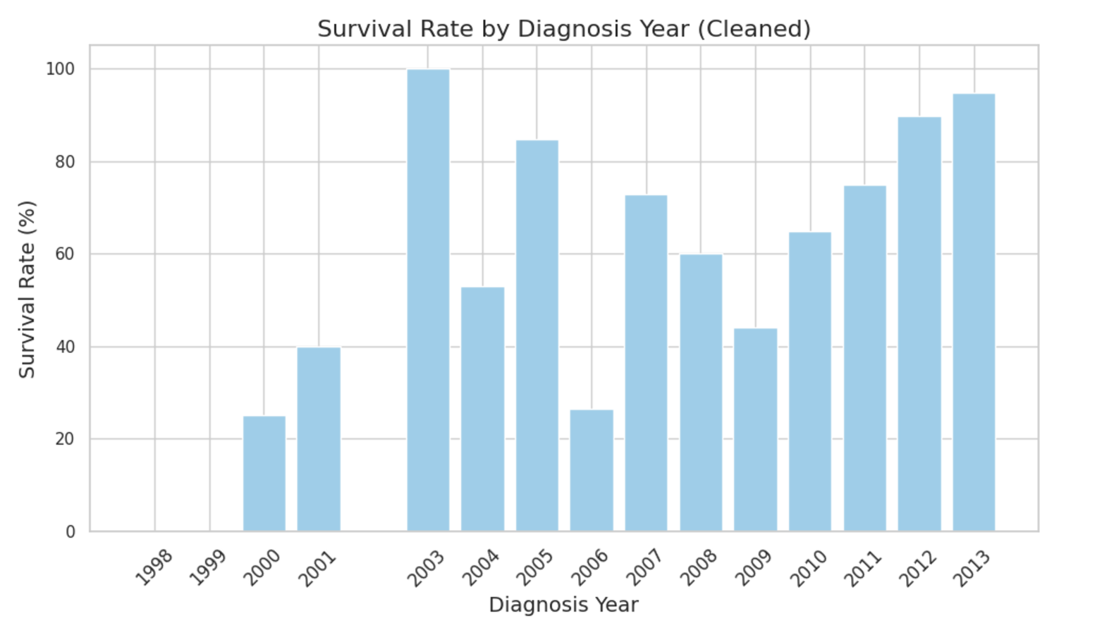
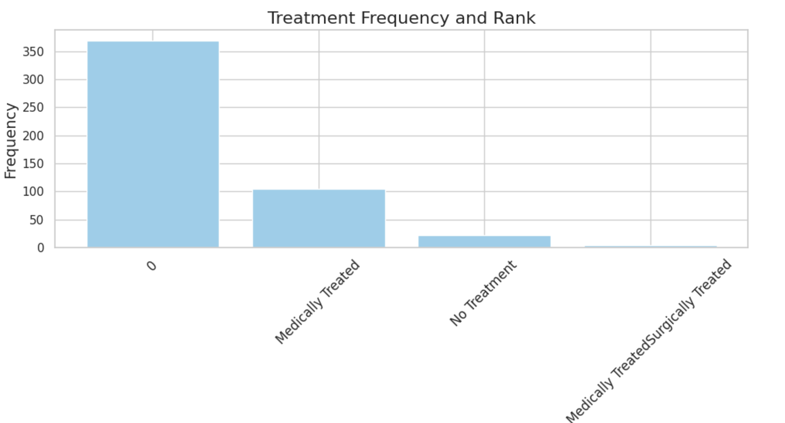
Survival rates by diagnosis year show a peak in 2003 and an upward trend, indicating improved treatments and patient care over time.
Most patients received no treatment, followed by medical treatment. Combined medical-surgical treatments were the least frequent

Slide 16
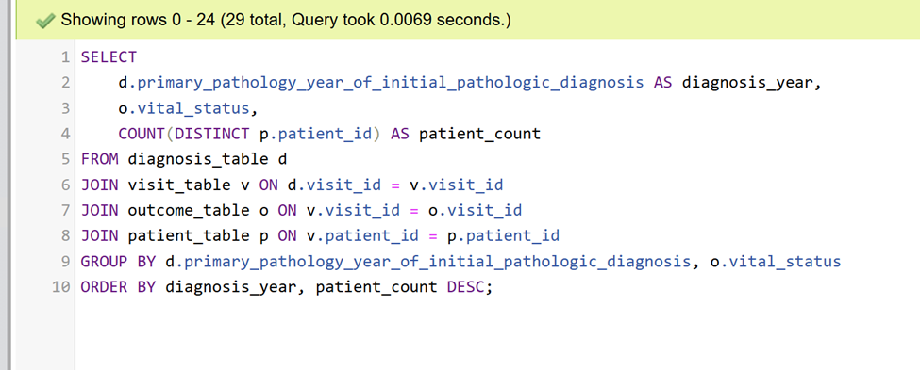
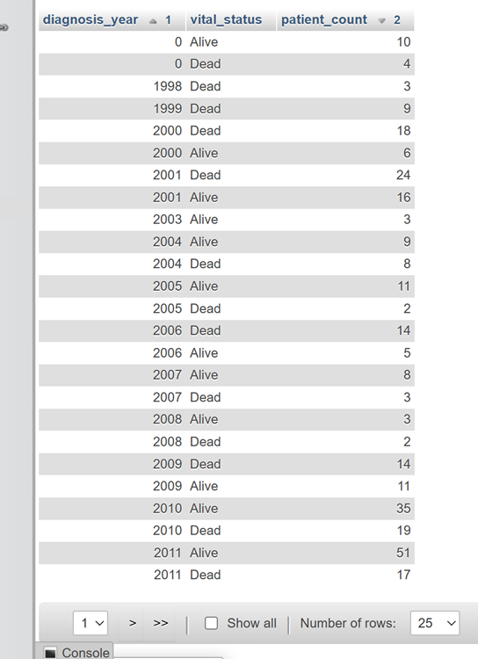
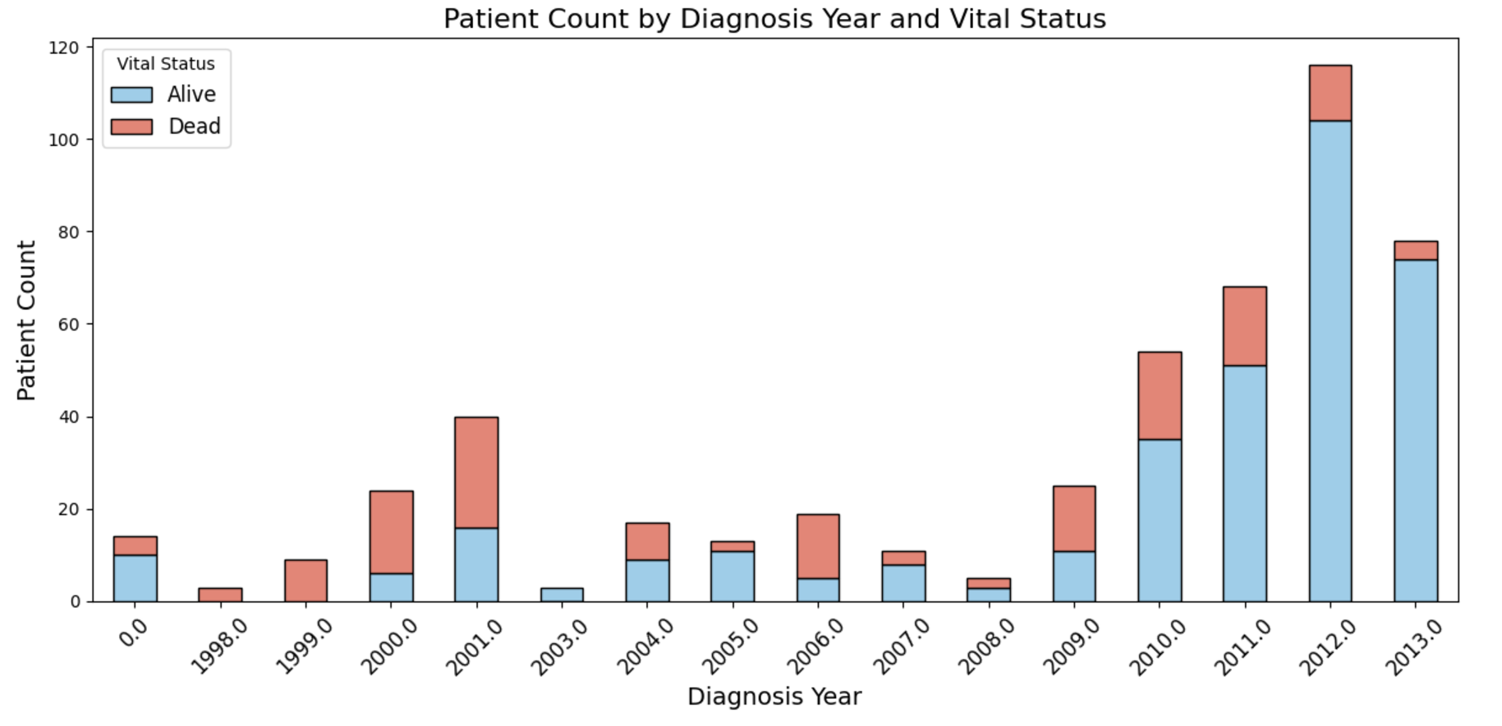
SQL QUERY
5. Analyzing Patient Counts by Diagnosis Year and Vital Status
Write an SQL query to determine the count of unique patients grouped by their primary pathology diagnosis year and vital status, sorted by diagnosis year and patient count in descending order.

Slide 17
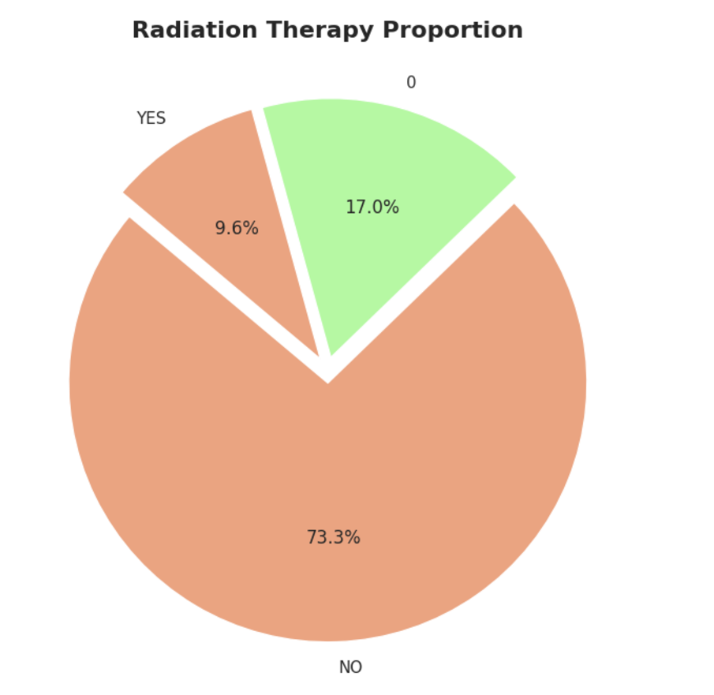
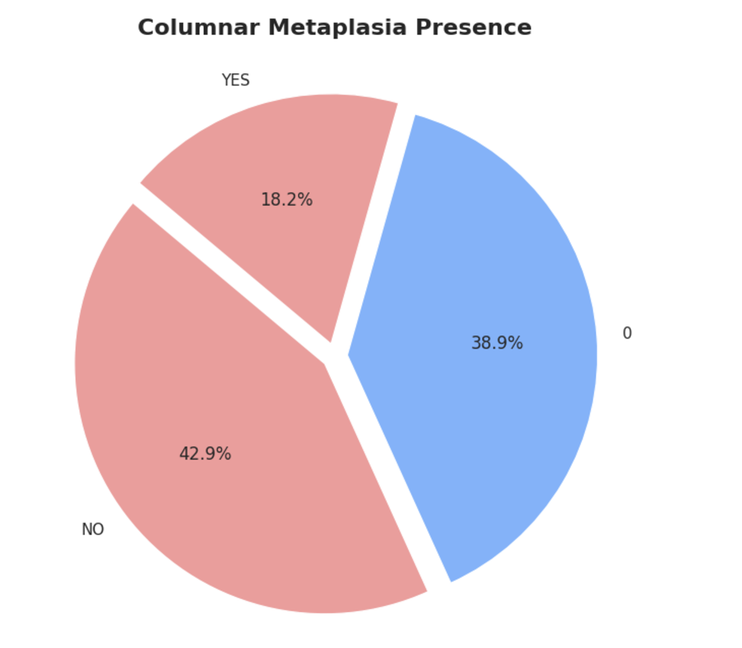
VISUALIZATION
73.3% of patients did not undergo radiation therapy, 17% have unknown therapy status, and 9.6% underwent radiation therapy.
42.9% of patients tested negative for columnar metaplasia, 18.2% tested positive, and 38.9% have unknown results.

Slide 18
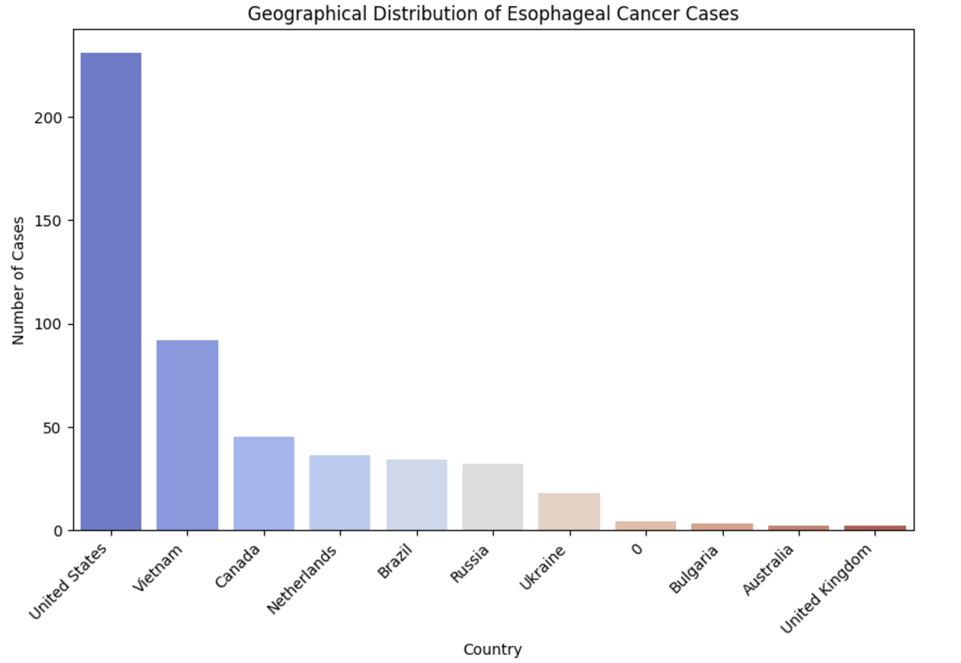
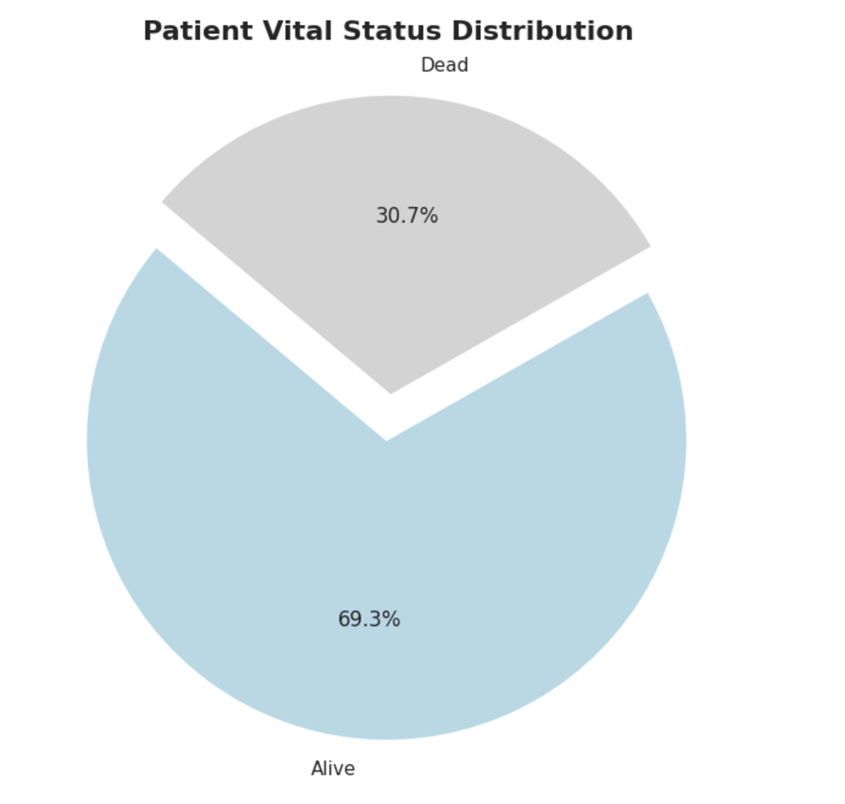
VISUALIZATION
The United States has the highest number of esophageal cancer cases, followed by Vietnam and Canada. Other countries contribute significantly fewer cases.
Patient vital status distribution shows 69.3% of patients are alive, while 30.7% have succumbed to the disease.

Slide 19
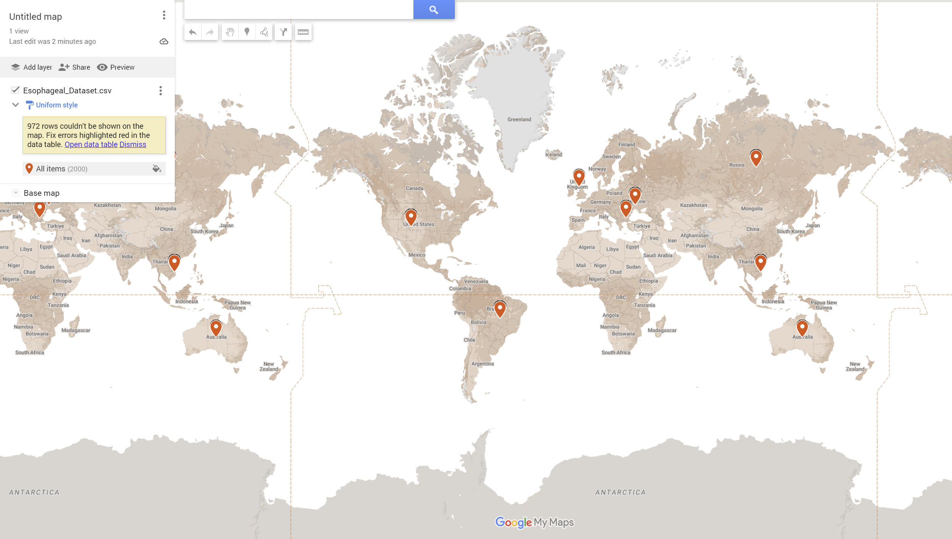
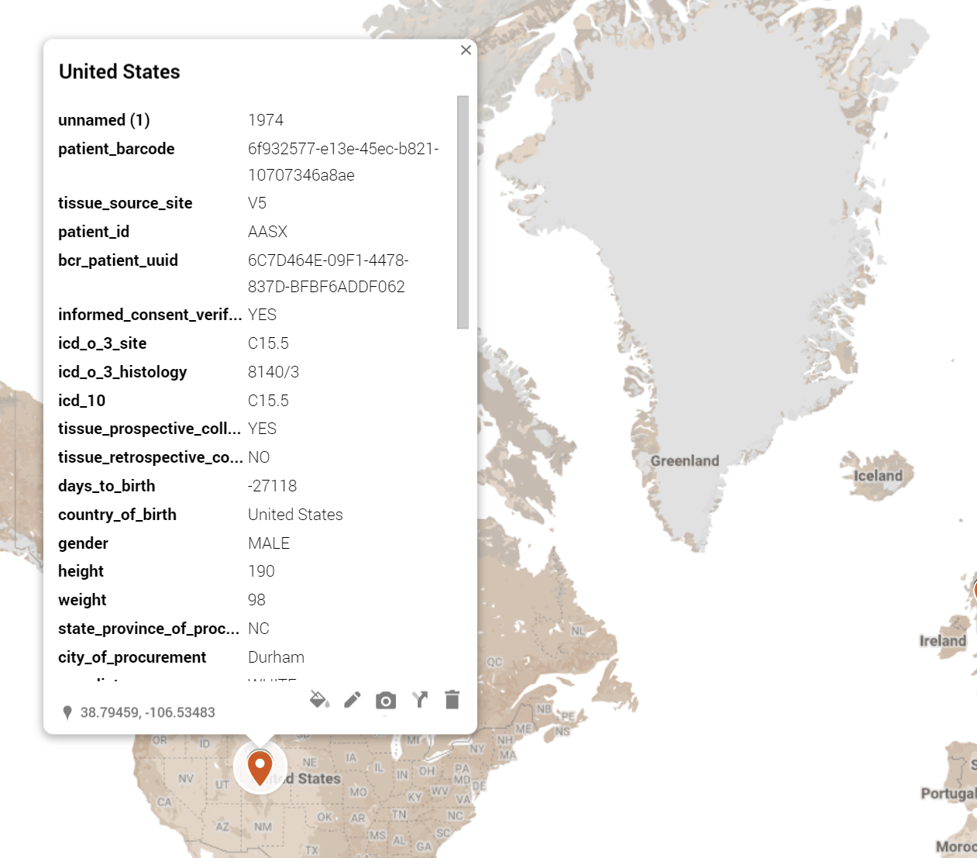
Distribution of Esophageal Cancer Cases Based on Patient Data: A Geographic Visualization

Slide 20

ANALYSIS
Model Evaluation and Feature Importance
The results from the Logistic Regression and Random Forest models show that both models perform moderately, with accuracy values of 0.53 and 0.49, respectively.
The confusion matrix for Logistic Regression reveals a relatively balanced prediction outcome, with 29 true positives and 23 false positives, indicating room for improvement in predictive accuracy.
On the other hand, the Random Forest model provides similar metrics with an accuracy of 0.49, precision of 0.47, and recall of 0.42. These values suggest that further tuning or feature engineering may be necessary for optimal performance.
Feature Importance Analysis The Random Forest feature importance chart highlights the significant predictors of treatment outcomes. Age emerges as the most important feature, followed by Tumor Stage, Treatment Type, and Gender. This information can guide clinicians in identifying critical factors influencing treatment effectiveness and patient survival.

Slide 21
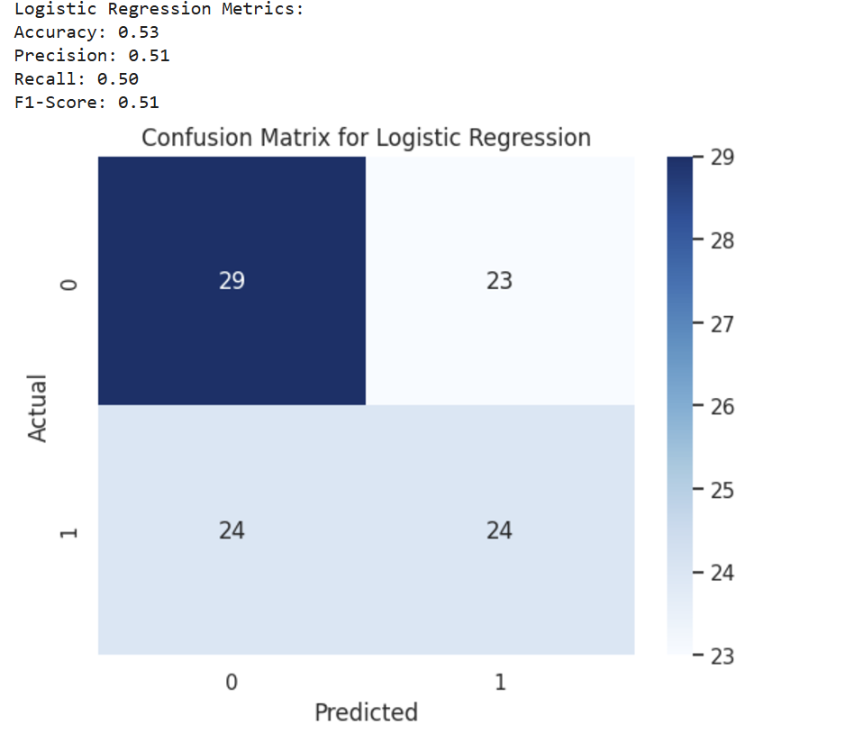
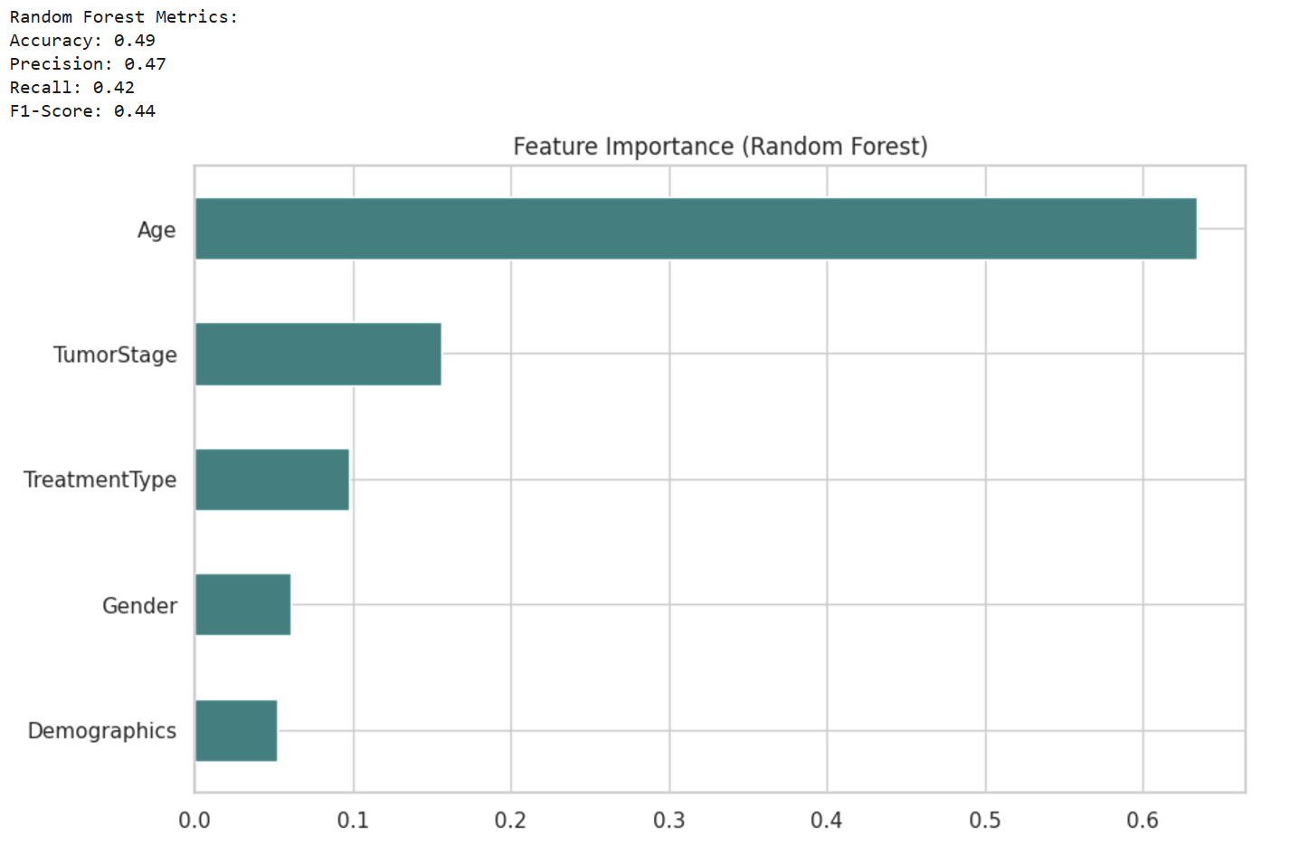
Logistic regression & Random forest

Slide 22
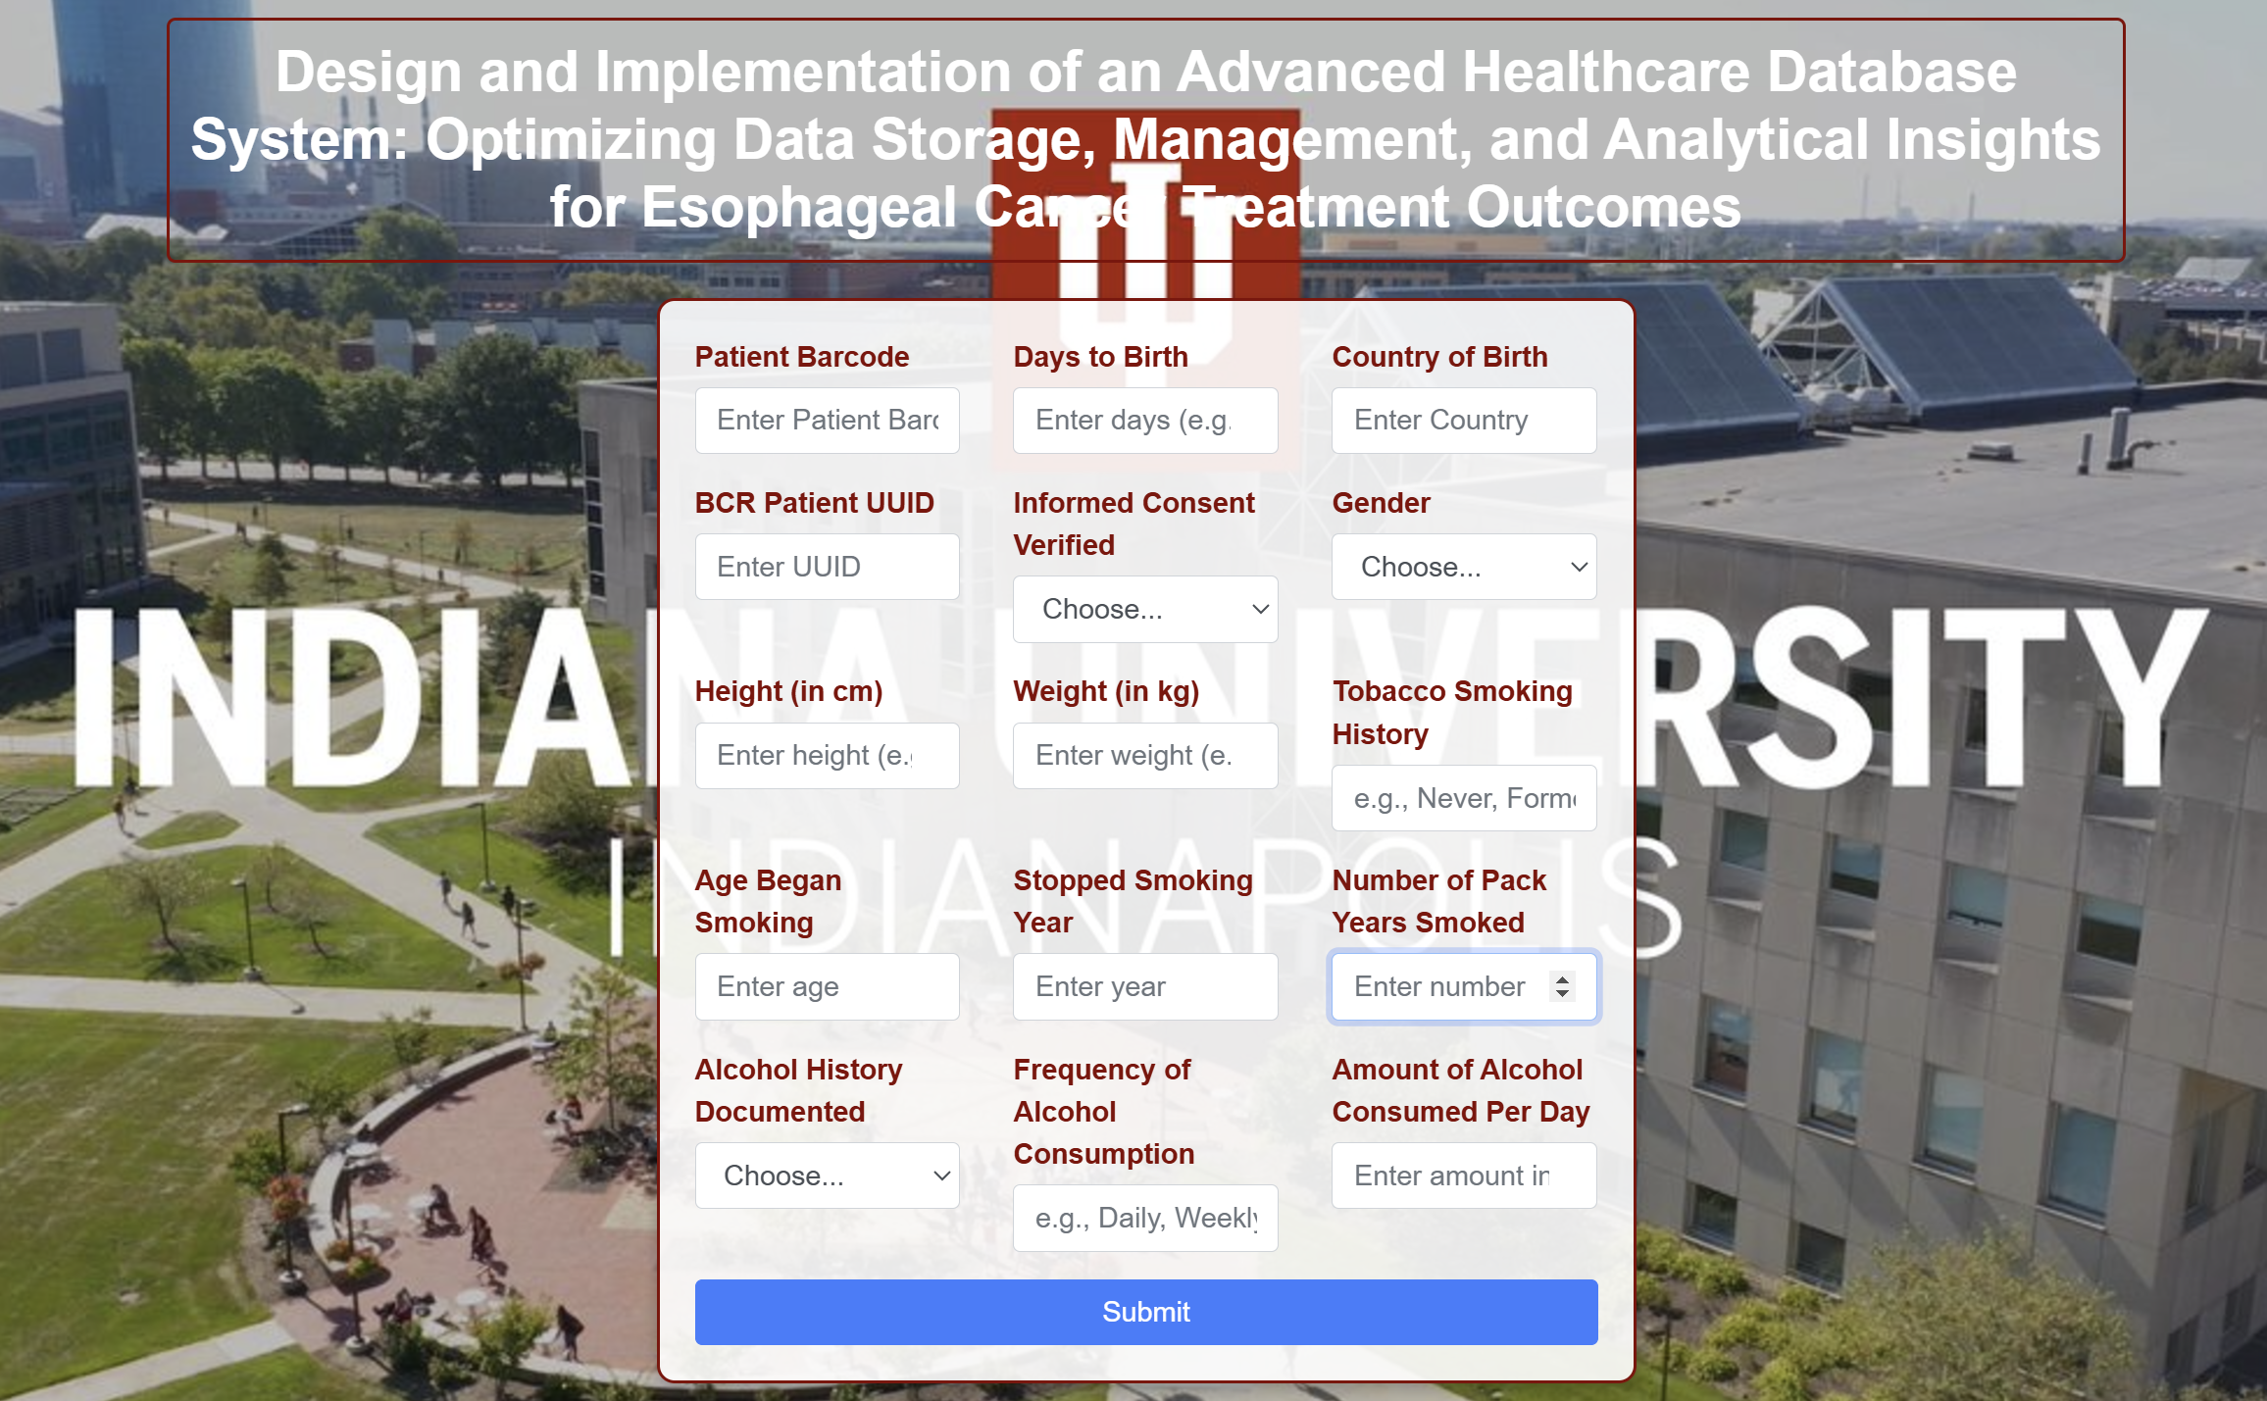
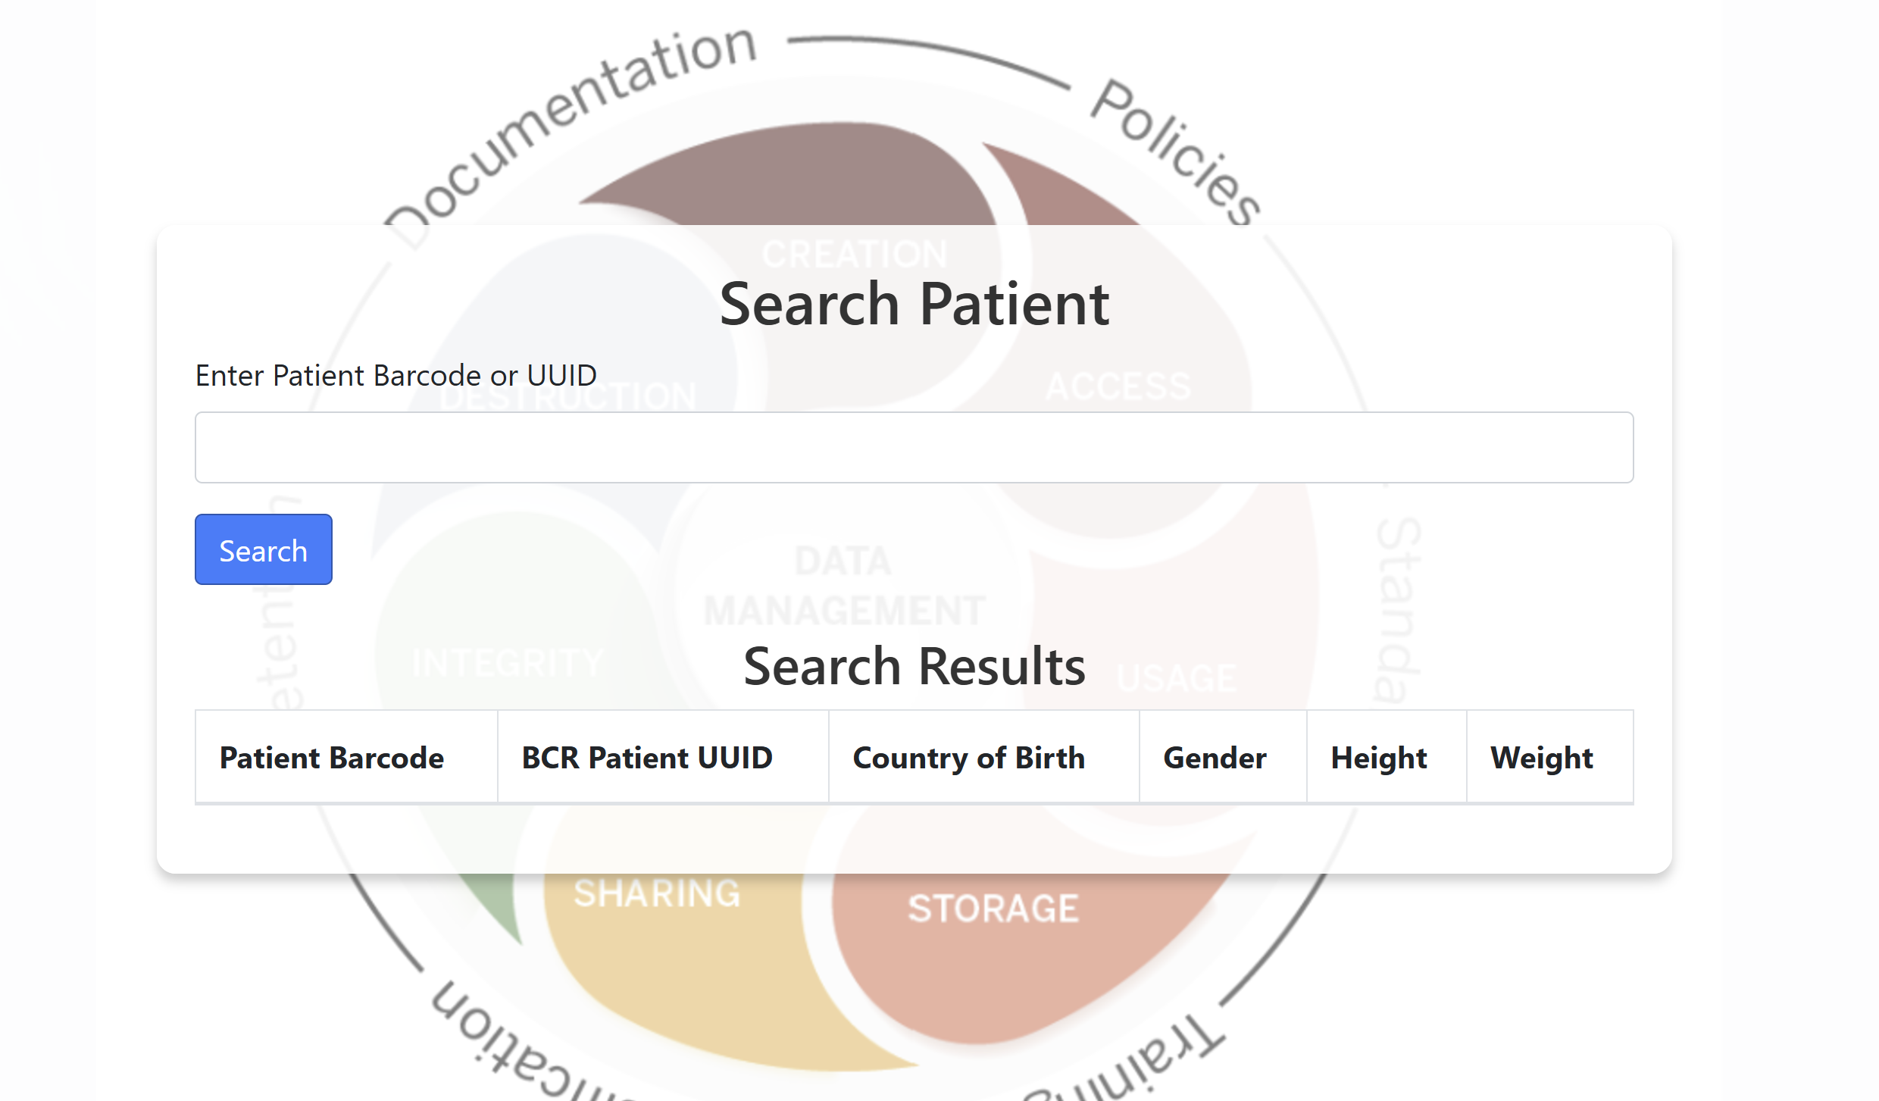
WEB INTERFACE

Slide 23
CONCLUSION
Designed a relational database for esophageal cancer data, integrating patient demographics, tumor details, treatment outcomes, and geographical information to support efficient data management and analysis.
Normalized data into a structured schema, enabling advanced analytics, real-time data querying, and predictive modeling for improved clinical decision-making and research insights.
Incorporated visualizations and geographical mapping, offering a comprehensive view of patient distributions, treatment trends, and regional disparities to aid healthcare interventions.
Identified critical insights, such as longer survival rates for distal tumors and high-risk regions like Ukraine, helping prioritize clinical and policy efforts.
Applied machine learning models, including logistic regression and random forest, to predict patient outcomes, optimize treatment strategies, and trigger early alerts for interventions.
Analyzed survival trends and treatment frequencies, visualizing key findings like increased antireflux treatments and improving survival rates by diagnosis year.
Established a future-ready system, supporting the inclusion of additional datasets and integration with clinical decision support systems (CDSS) for broader applications.

Slide 24

THANK YOU

